Slide 1

HBACA 2026 Trench Safety
Stand Down Presentation

Slide 2
This Presentation will provide information about basic Trenching Operations to help you ensure a Safe Working Environment.
Trenching and Excavation is dangerous work that construction workers face daily.
Depending on the task at hand, there are different risks involved.
Let's dig into the differences between trenching and excavation, the hazards involved, and how to mitigate risks while working.

Slide 3
Excavation vs. Trench
An excavation is defined as any man-made cut, cavity, trench, or depression in the Earth’s surface formed by earth removal.
A trench is defined as a narrow excavation (in relation to its length) made below the surface of the ground.
In general, the depth of a trench is greater than its width, but the width of a trench (measured at the bottom) is not greater than 15 feet

Slide 4
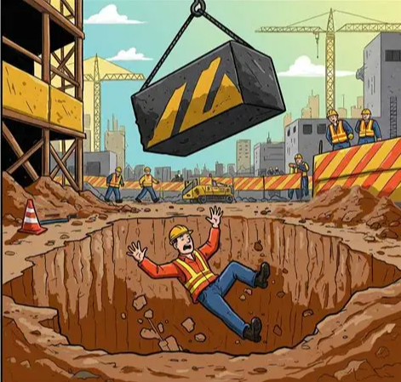

Slide 5
Trench Hazards
Trenching and Excavation tasks can be deadly if they are not performed using the controls outlined in this training.
Always take Trenching and Excavation Hazards Seriously, as even a 3-foot cave-in can cause a fatality.

Slide 6
Hazards of Trench and Excavation Work
Workers who dig, excavate, or work around and in trenches are at risk of death if they enter an unprotected trench and the walls collapse.
The lack of a protective system is the leading cause of the trench-related fatalities.
Hazards associated with trench work and excavation are recognized and preventable, yet injuries and fatalities associated with these hazards continue to occur.
Engineering controls, protective equipment, and safe work practices to minimize worker’s hazards during trench work and excavations are required.
The OSHA Standards outline the specific requirements for excavations (1926.651) and requirements for protective systems (1926.652).

Slide 7
Requirements for Protective Systems
Trenches 5 feet deep or greater require a protective system unless the excavation is made entirely in stable rock.
If less than 5 feet deep, a competent person may determine that a protective system is not required.
Trenches 20 feet deep or greater require that the protective system be designed by a registered professional engineer or be based on data approved by a registered professional engineer.

Slide 8
Types of Protective Systems
The following are types of protective systems that are used to prevent cave-ins.
Designing a protective system can be complex. Considerations include soil classification, depth of cut, the soil's water content, changes caused by weather, surcharge loads (e.g., spoil, other materials to be used in the trench), and other operations in the area.

Slide 9
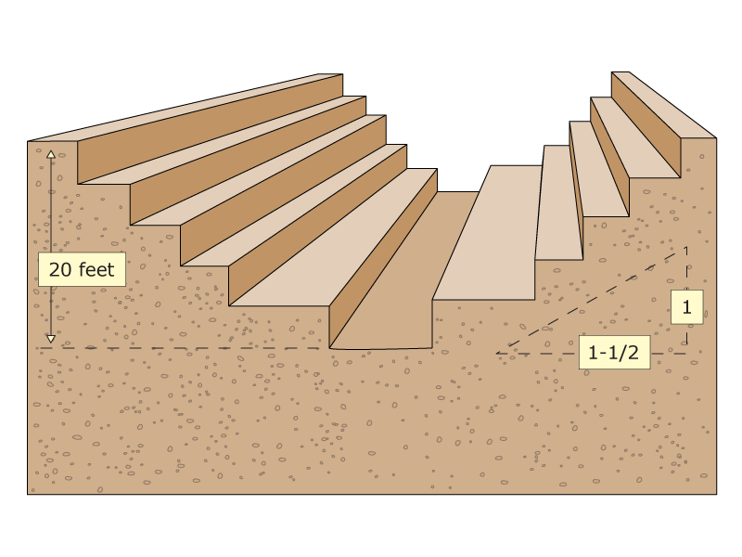
Benching
Means a method of protecting workers from cave-ins by excavating the sides of an excavation to form one or a series of horizontal levels or steps, usually with vertical or near-vertical surfaces between levels. Benching cannot be done in Type C soil. Type C soil is classified as the least stable type of soil, and examples include gravel and sand.

Slide 10
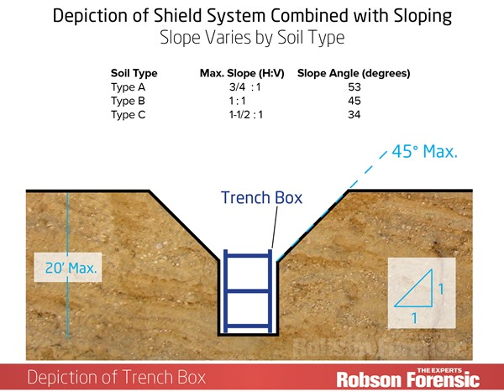
Sloping
Involves cutting back the trench wall at an angle inclined away from the excavation.

Slide 11
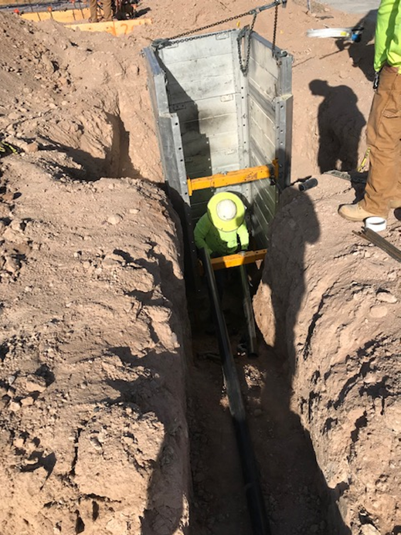
Shielding
Protects workers by using trench boxes or other types of supports to prevent soil cave-ins and must remain 2 feet above the top of the Trench

Slide 12
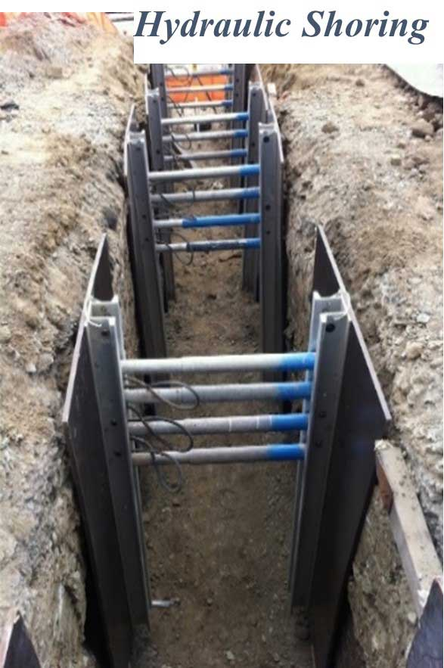
Shoring
Requires installing aluminum hydraulic or other types of supports to prevent soil movement and cave-ins.

Slide 13
Safe Work Practices for Trench Safety
The Best Practices outlined below are critical elements to keeping you Safe when working in a Trench or around an Excavation.
Plan the job before starting by laying out a safe locations away from the trench for spoil piles and heavy equipment routes
heavy equipment can cause stability problems of the trench
Keep excavated soil (also known as spoils) and other materials at least 2 feet from the trench's edge
Know where underground utilities are located before digging. Always call 811 so that utility lines can be marked
Do not work under suspended loads
Ensure that all personnel working in or around the trench wear high visibility vests or shirts
Ladders should never be more than 25 feet from any worker in the trench over 4' in depth for access and egress.
  A-frame ladders are ok to use so long as they extend 3' above the trench.
Remember the deepest part of the trench needs to have double row of Caution Tape around the trench top to call attention to the Hazard

Slide 14
Know the Colors for Utility Markings before you excavate or dig in the ground
Utilities are marked in colors based on their type. Locators use the Uniform Color Code for Utility Markings so utilities can always be identified by their specific color, whether they’re marked with paint, flags or whiskers.
Proposed Excavation - White
Temporary Survey - Pink
Electric Power - Red
Natural Gas, Oil and Liquid Fuels - Yellow
Communications, Fiber Optics and Cable TV - Orange
Water and Slurry Lines - Blue
Reclaimed Water - Purple
Sanitary Sewer Systems - Green

Slide 15
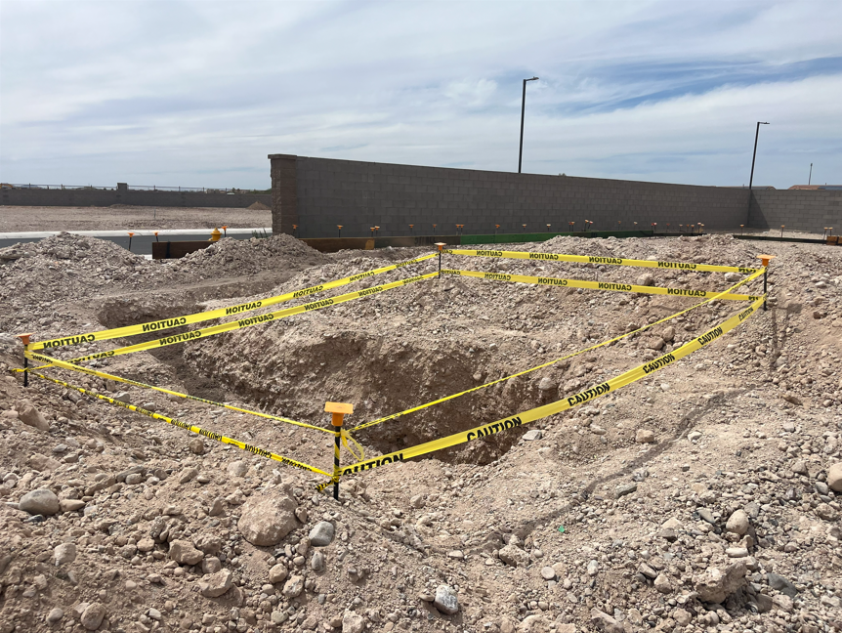

Slide 16
Wrap-Up / Questions / Commitments
Key takeaways: Protect the trench, control the edge, and always maintain safe access/egress.
Stop-work commitment: If conditions change or something looks unsafe, stop and notify the competent person/foreman.
Questions: What hazards are we most likely to face today? What controls are we using?
Close-out: Confirm roles, communications plan, and that everyone understands the plan before work starts.

Slide 17


Slide 18
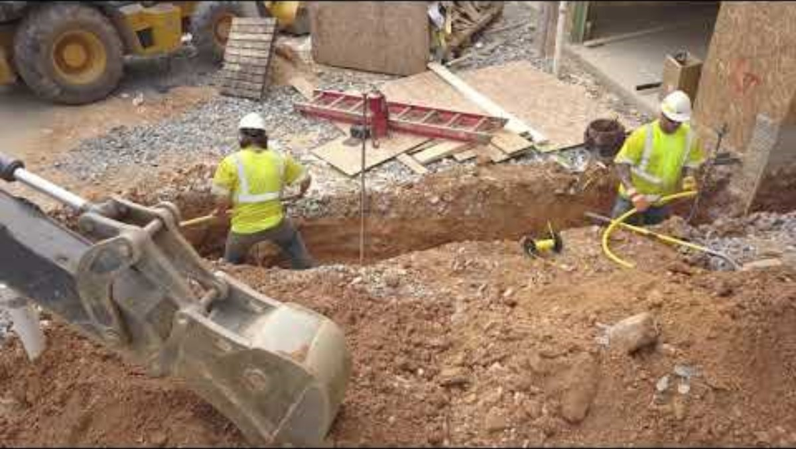

Slide 19
Equipment: Safe Condition / Working Order
Expectation: Only use equipment that is in safe working condition. (shoring)
  Pre-task inspections: (Job Hazard Analysis) Identify and review essential inspection points for your equipment, including guards, hydraulic systems, lighting and alarm functionality, tires or tracks, pins, personal protective equipment (PPE), and other pertinent safety features.
Tag-out: If unsafe, stop and remove from service; notify [Supervisor/Foreman].

Slide 20
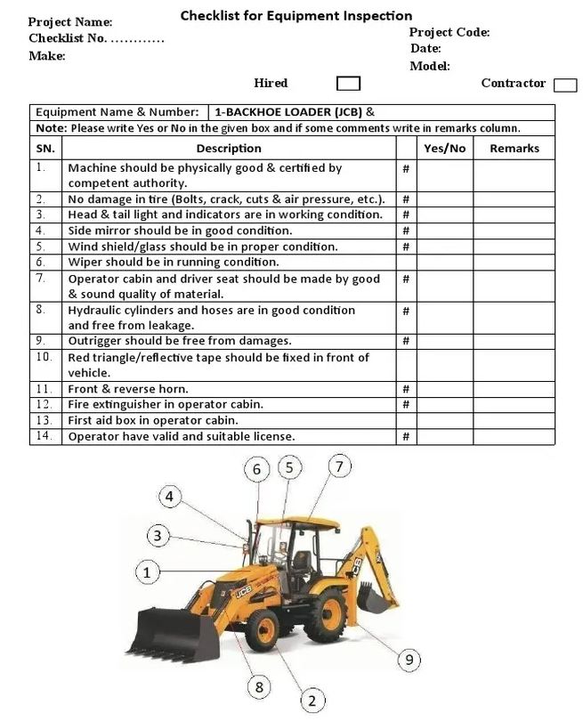

Slide 21
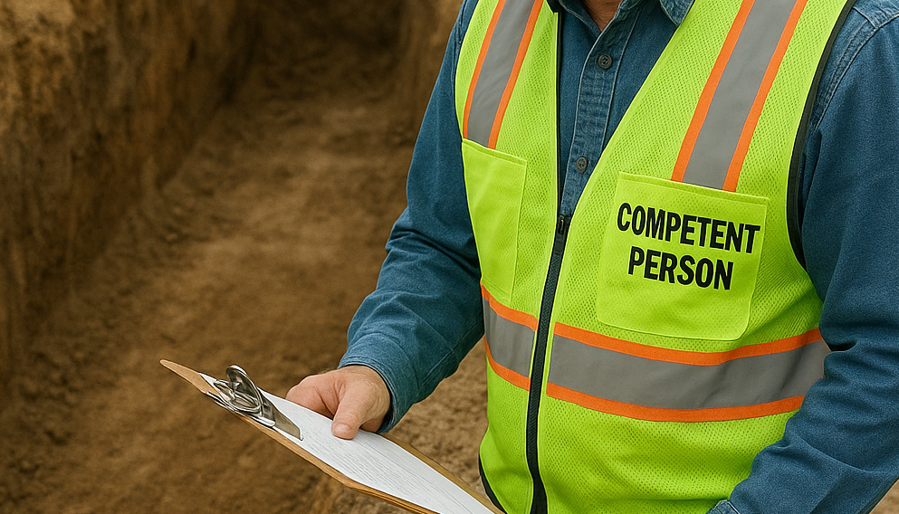

Slide 22
Competent Person (Definition & Duties)
Definition (trenching/excavation): A person who can identify existing and predictable hazards in and around an excavation (e.g., cave-in risk, protective system issues, water, atmospheres, access/egress) and has authority to take prompt corrective action, including stopping work and removing employees from danger.
Soil types (OSHA): Stable Rock—natural solid mineral that can be excavated with vertical sides and remain intact; Type A—most stable soil; Type B—medium stability; Type C—least stable (often granular/sandy or with water/seepage). Competent person must classify based on site conditions and tests.
Responsibilities: Daily inspections; classify soil; select protective system; verify access/egress; control water; stop work when unsafe.
Local note: Arizona soils are often treated as Class C unless testing/classification supports otherwise (confirm per your program).
Trigger events: Re-inspect after rain, vibration changes, spoil movement, utility discovery, or any hazard-increasing event.

Slide 23
Spoil Piles / Materials at the Edge
Spoil Piles / Materials at the Setback: Keep spoil/materials far enough from the edge to prevent cave-ins and falling material.
  Housekeeping: Ensure edges are tidy and make sure walkways and ladders are unobstructed.
Equipment positioning: Keep heavy equipment back from the edge; account for vibrations and surcharge loads.

Slide 24
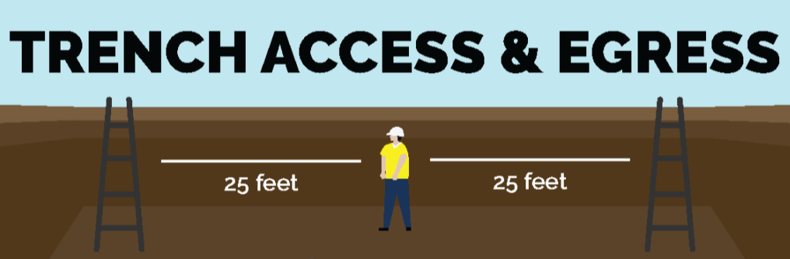

Slide 25
Access & Egress (Ramps / Steps / Ladders — 25 ft Rule)
Requirement: Provide a safe means of exit so workers do not travel more than 25 ft laterally in the trench to reach it.
Options: Ladder(s), ramp, steps—appropriate for depth and conditions.
Keep clear: Do not block access points with spoil, materials, or equipment.
Inspection: Competent person verifies access/egress each shift and after any hazard-increasing event. Who is considered a competent person?

Slide 26
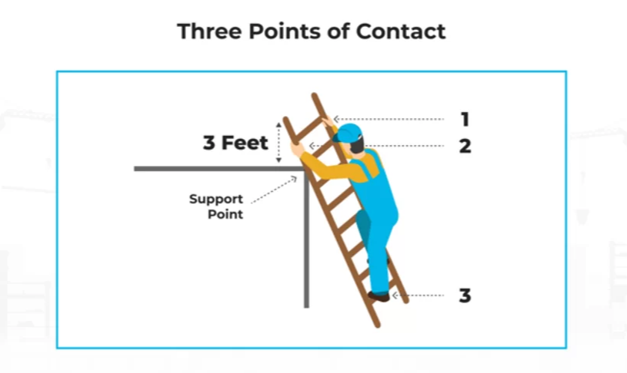

Slide 27
Ladders & Points of Contact
Always inspect PPE
Condition: Inspect before use; remove damaged ladders from service.
Points of contact: Ensure you keep three points of contact at all times when climbing or descending. And the ladder must extend 3 ft above the landing
Access/egress tie-in: Ladder/ramp/stairs must be available, so workers never travel more than 25 ft laterally to exit.

Slide 28
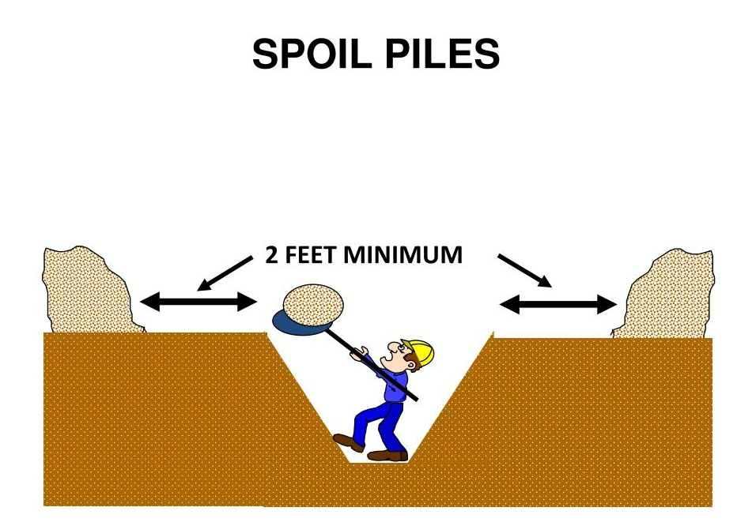

Slide 29
Common Trench Hazards
Environmental / Site Conditions
Vibrations: Traffic, equipment operation, compactors—can affect trench stability.
  Soil types: Understand how soil is classified and determine which protection methods are necessary.
Hazardous atmospheres/gases: Especially near sewer lines or decomposing material—monitor as required.
Heat: Hydration, shade, and work/rest planning.
Moisture/water: Rain, leaks, groundwater—can weaken walls and increase collapse risk.
Breaks/rest: Plan recovery and rotate tasks to prevent heat stress/fatigue.

Slide 30
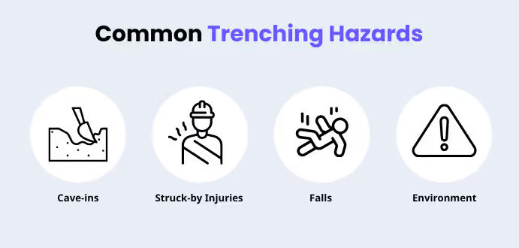

Slide 31
Top Incident Types: Falls & Struck-By
Falls (often #1): Barricades, covers, designated access, good lighting, clean edges, no jumping across.
Struck-by: Spotters, exclusion zones, equipment setbacks, communication, stay out of swing radius, proper staging.
Second-person check: Watch each other—call out hazards immediately.

Slide 32
Caution Tape / Barricades
When required: Open excavations/trenches, limited visibility, public exposure, weekends/holidays,
How to set up: Keep tape/barricades far enough back to prevent falls and to keep equipment away from the edge. 2ft all the way around the excavation/trench
Ownership: Who is responsible for putting up, checking, and taking care of barricades? Everyone’s responsibility
Do not: Step over/duck under or alter —use designated access points.

Slide 33
Weekends / Holidays: Secure the Site
Goal: No unprotected open holes/trenches left accessible when crews are off-site.
Controls (choose what applies): Caution tape/barricades; fencing; trench plates/covers; backfill; signage; lighting.
Responsibility:

Slide 34
Here are a few General Precautions while Working in or Around a Trench or Blue Stake / Utility Locates (811)
Before you dig: Confirm locate ticket is current and covers the work area.
Markings: Review what each marking means
Common marking colors (American Public Works Association—APWA): White–proposed excavation; Pink–temporary survey; Red–electric; Yellow–gas/oil/steam; Orange–communications; Blue–potable water; Purple–reclaimed water/irrigation; Green–sewer/drain.
Exposure: Use approved methods to expose utilities (e.g., potholing) before mechanical excavation near lines.
Stop work: If markings are unclear or a line is found, stop and notify [Supervisor/Utility].

Slide 35


