Slide 1



Mental health at Work
Presented by:
Heather Danielson
C&S Sweeping Services
Heather@Candssweeping.com
Jesus Urias
Austin Companies
Jurias@Austincompanies.com

Slide 2
Agenda
Data
Case Study
Ways employers can help
Ways you can help
Breathing exercise
Mindfulness exercise
Resources
Notes:
Speaker: Jesus

Slide 3
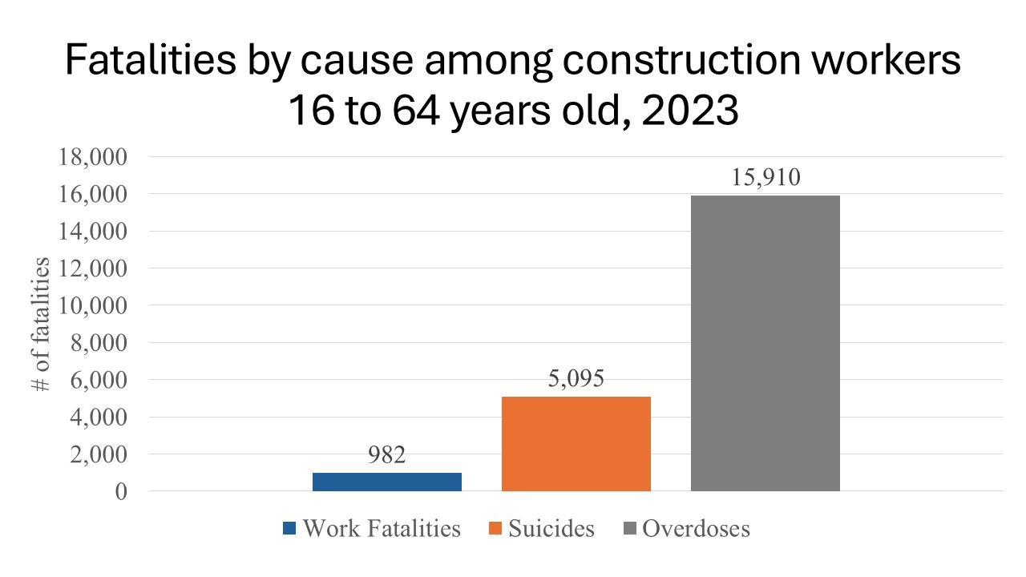
The Silent Killer
982 Work Fatalities
404 Falls
154 Struck-by
66 Electrocutions
40 Caught-in/between death
5095 Deaths by Suicide
15,910 Overdoses
Notes:
Speaker: Jesus

Slide 4
Case study
Has anyone gone through a similar situation?
Notes:
Speaker: Heather

Slide 5
Signs and Symptoms to be aware of
Feeling sad, tearful, or hopeless
Feeling irritable or frustrated
Feeling worthless or guilty
Feeling tired or low energy
Losing interest in things you typically enjoy
Difficulty concentrating or making simple decisions
Trouble completing your tasks and activities
Changes in appetite, weight, or sleep
Notes:
Speaker: Jesus

Slide 6
How employers can help
Perform a stand down
Informative posters
Toolbox talks
Poker Chips
Open Door policy
Human Resources
Mental Health and Suicide prevention Training
Notes:
Speaker: Heather

Slide 7
How you can help
Encourage them to:
Regularly exercise, eat healthy, and get 7–9 hours of sleep
Spend time with loved ones
Practice meditation (use apps or videos)
Breathing exercises (Navy Seal Box Breathing)
Make time for low-stress activities they enjoy (Vacation)
Volunteer to help others
Mindful eating exercise
Notes:
Speaker: Jesus

Slide 8
H.A.L.T.
Hungry
Angry
Loneliness
Tired
Notes:
Speaker: Heather

Slide 9
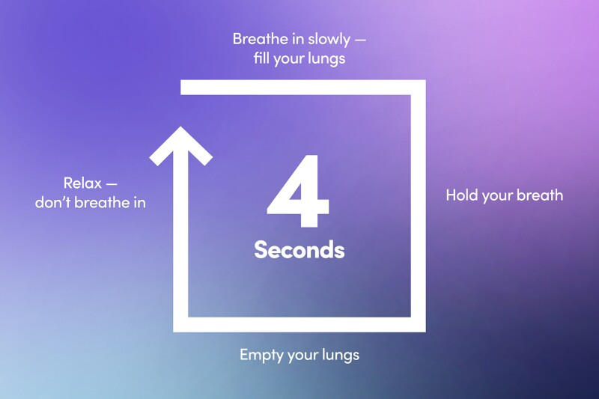
4-4-4-4 Box Breathing
Notes:
Speaker: Jesus

Slide 10

Notes:
Speaker: Heather

Slide 11
Mindful eating exercise
Set your timer for 10 minutes. Make sure the immediate environment is distraction-free. Put away your cell phone and turn off the tv.
Hold an orange in your hands, gently cupping it to feel its round shape and experience its weight.
Rub your fingertips along the peel and observe the subtle, rubbery texture.
Pierce it with your fingernail to open it. Feel the juice run onto your finger.
Lift it to your nose, watching the orange come close, and breath in deeply, reveling in the scent.
Put your tongue on the exposed part of the fruit and let a bit of juice settle on your tongue. Note the feel of the liquid and the taste of the juice.
Now, peel it completely. Rub the peel between your fingertips and note the contrast between the outside and inside. Feel the stickiness of the juice.
Listen to the sound the orange makes as you gently separate the segments.
Visually explore the nuances of color, the textured lines, and the small white seeds.
Eat the orange slowly, taking small bites out of each segment and chewing and swallowing deliberately. How does it feel in your hands? Your mouth? How does it taste?
Notes:
Speaker: Heather

Slide 12
Benefits of an orange for immediate health
When you eat an orange, you can experience immediate benefits from its high-water content and natural sugars. These benefits include hydration and a natural energy boost, helping to reduce feelings of fatigue.
Hydration
An orange is made of over 85% water, making it an excellent snack for rehydrating your body. Staying hydrated is vital for proper bodily functions, including regulating temperature, improving digestion, and maintaining energy levels.
Energy boost
The natural carbohydrates and sugars in an orange provide a quick source of fuel for your body. The fiber content in whole oranges helps regulate how quickly the sugar is absorbed, giving you a steady, sustained energy boost rather than a sudden spike and crash. The vitamin C in oranges also helps combat fatigue by reducing oxidative stress in the body.
Rapid nutritional absorption
While the more significant benefits of an orange's nutrients build up over time, your body begins absorbing them almost immediately.
Notes:
Speaker: Jesus

Slide 13
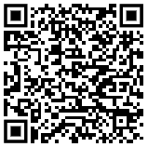

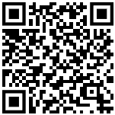



Links to resources
Mental Health & Suicide Prevention Course
988 Lifeline
SAMHSA - National Helpline for Mental Health, Drug, Alcohol Issues
OSHA - Preventing Suicides in Construction
HBACA – Safety Resources
GHBA – Mental Health in Construction
Notes:
Speaker: Heather & Jesus

