Slide 1
Extreme Weather (Heat) Management

Slide 2
Arizona is known for its extremely hot and long mornings, mid days and nights…there’s no escaping the heat here.
Extreme heat is deadly and kills more Arizona residence and visitors each year, than any other weather event.
If you’re not careful, the heat can cause your body to experience some very unfortunate and painful illnesses and injuries such as…

Slide 3
Heat Related Illnesses detection and management
Heat Stroke
Heat Exhaustion
Symptoms
High body temperature (104°F or higher)
Hot, red, dry or damp skin
Fast, strong pulse
Headache-Dizziness
Nausea-Confusion-Passing out
WHAT TO DO:
Call 911 right away, then:
Move to a cool place
Cool the body using wet cloths, misting, fanning, or a cool bath
Do NOT give the person anything to drink
Symptoms
Heavy sweating
Cold, pale and clammy skin
Fast, weak pulse
Nausea or vomiting
Muscle cramps
Tiredness or weakness
Dizziness-Headache-Passing out
WHAT TO DO:
Sip water slowly
Cool person down with cold compress, rag or ice pack
Seek Shade
Loosen clothing
Seek medical help if you…
  Start vomiting
  Become daisied and confused
  Symptoms last longer than 1 hour

Slide 4
Heat Related Illnesses detection and and management cont.
Heat Cramps
Heat Rash
Symptoms
Cool, moist skin
Heavy sweating with muscle pain
Dilatated Pupils
Extreme thirst
Tiredness, Weakness
WHAT TO DO:
Seek shade immediately
Consume water or sports drink
Seek medical help if cramps last longer than 1 hour
Symptoms
Red raised bumps on skin (usually around the neck & chest)
Itchy, irritable skin
WHAT TO DO:
Keep rash area dry
Use powder on skin
Seek shade

Slide 5

2025 Arizona confirmed heat associated deaths

Slide 6
Ways to Beat the Heat!
There are many ways we can stay safe and Beat the Heat like…
Check the weather forecast and UV Index for the next day before work
Cover up, the less skin exposed to the heat rays the cooler the skin will stay
Hydrate, remember hydration starts the day before and not the day of.
  Its important to avoid sugary, caffeinated and alcoholic drinks.
If you are sweating a lot, combine water with snacks or a sports drink to replace the salt and minerals you lose in sweat.

Slide 7
Ways to Beat the Heat cont.
5. Use your resources for assistance in creating a plan when having workers working in extreme heat.
  Arizona Dept. of Health Services @ (602) 364-3118
  Preplan locations of A/C Cooling Centers
    Locations can be found @ ADHS.gov
    (go to the search index and type in HEAT ILLNESS)

Slide 8
2026 AZ Heat Task Force Need to Know
NOT YET A “LAW”
  Approved by ADOSH Advisory Committee 3/2026
  Expected roll out date “Summer” 2026
  Enforcement happening through ADOSH Heat SEP + the 1A

Slide 9
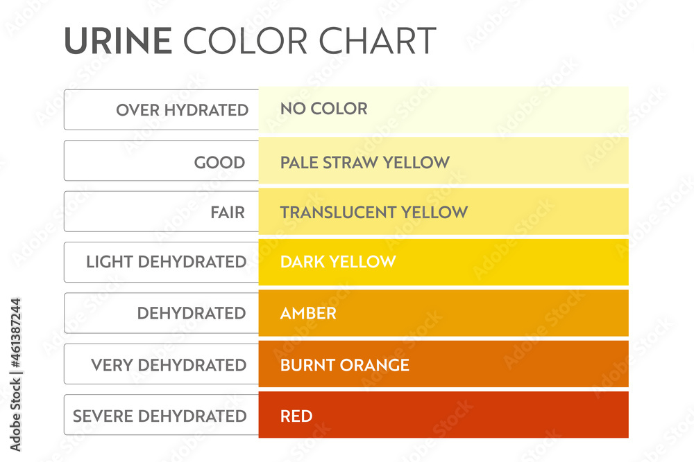

Slide 10
AZ Heat Task Force
Mandatory Shift to a WRITTEN HIPP Program
Who – Every employer
Procedures that detail a specific
  Water distribution procedure
  Shade / cooling access
  Rest break policy
  Acclimatization process
  Training
WHAT IS IT?

Slide 11
AZ Heat Task Force
Water Requirements
(now QUANTIFIED not just provided)
Potable, cool and accessible
Located close to work area
Quantity defined
  1qt per worker per hour
    If not continuously supplied
WHAT IS IT?

Slide 12
AZ Heat Task Force
Shade and Cooling
(functionality focused not just presence)
Nature or Artificial or AC
Large enough for worker on break
Ventilated / open airflow
WHAT IS IT?

Slide 13
AZ Heat Task Force
Rest and Cool Down rights
Workers permitted to….
  Take a preventative cool-down break as needed
  Access shade without discipline or delay
WHAT IS IT?

Slide 14
AZ Heat Task Force
Formal Acclimatization
(must be documented, not informal)
Required for…
  New Hires
  Returning workers
  Workers exposed to high heat or PPE burden
WHAT IS IT?

Slide 15
AZ Heat Task Force
Training requirements…
Must include…
  Signs / symptoms
  First Aid & Emergency Response
  Hydration practices
  Company heat procedures
  Workers Rights
  Delivered in all languages relevant to field personnel
  Annually or when revised
WHAT IS IT?

